Slide 1
Formulae Encyclopedia 2.0

Slide 2
Acknowledgement
Our team would like to express a deep sense of thanks and gratitude to our Department of Electronics and Computer Engineering of Thapathali Campus for this great opportunity to present our ideas. We would also like to thank Er. Saroj Shakya Sir for guiding us immensely throughout the project. His constructive advice and constant motivation have been responsible for the successful completion of this project .

Slide 3
Introduction To Formulae Encyclopedia 2.0
“Formula Encyclopedia 2.0” is the refurbished version of our first project “Formula Encyclopedia” related with all the formula required for the students. As finding a certain formula can get difficult, in general, this program is made to provide the users each and every formula required in the semesters of BCT.
Sometimes it can be difficult to come up with a solution to a certain issue. In turn, the solution to the problem cannot advance if a specific formula cannot be found. Finding the right formulas can be particularly challenging for pupils since there may be several formulas for a same problem.
Right Now, our app only supports limited formulas used in the first ,second and third semester course of field of Computer Engineering at IOE
Furthermore, this app provides the quick search feature as well as the subject-wise categorization of the formulae.

Slide 4
Why Formulae Encyclopedia 2.0?
As we are all aware , engineering is one of the toughest study field with the widest variety in the course content which covers almost every discipline of science and math. Hence there is no ignorance of the fact that every students pursuing this field are pressurized by the humongous number of the formulae it accompanies burdening the students to remember them. Therefore , Formulae encyclopedia 2.0 comes in handy as a great assistance for the students.

Slide 5
Methodology
The core programming of this project has been written on Qt 5.0 Code and compiled using g++.
The project has been achieved with the help of built in templates of Qt 5.0
We’ve used database management system(MYSQL) to manage the formula database and login credentials.
Database management and GUI is the fundamental aspect of this application

Slide 6
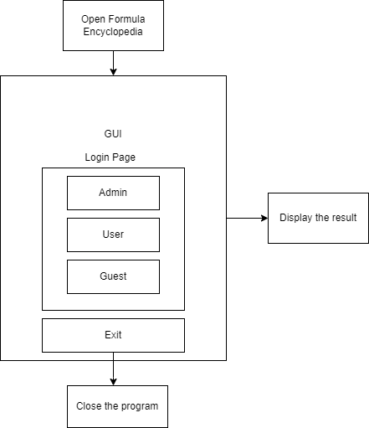
Methodology
GUI based Application
Has 3 different modes to log in
Admin
To register, delete, view users
User
Look for a formula
View formula sorted by subjects
Guest
View limited formulas

Slide 7
Methodology

Slide 8
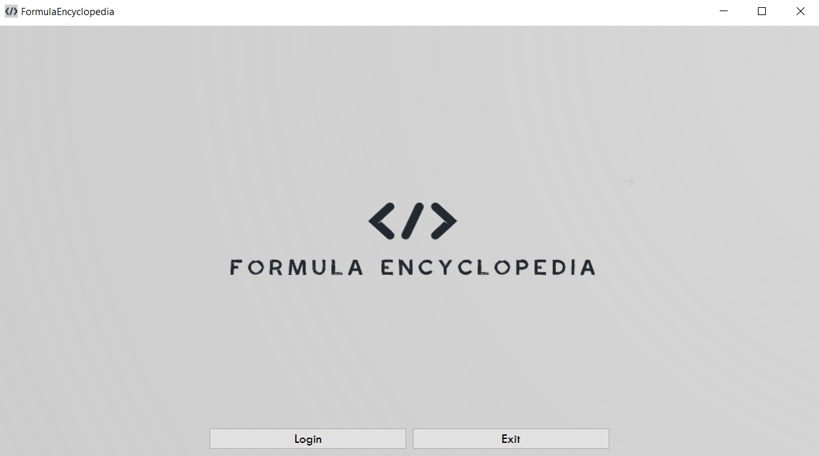
Home Screen

Slide 9
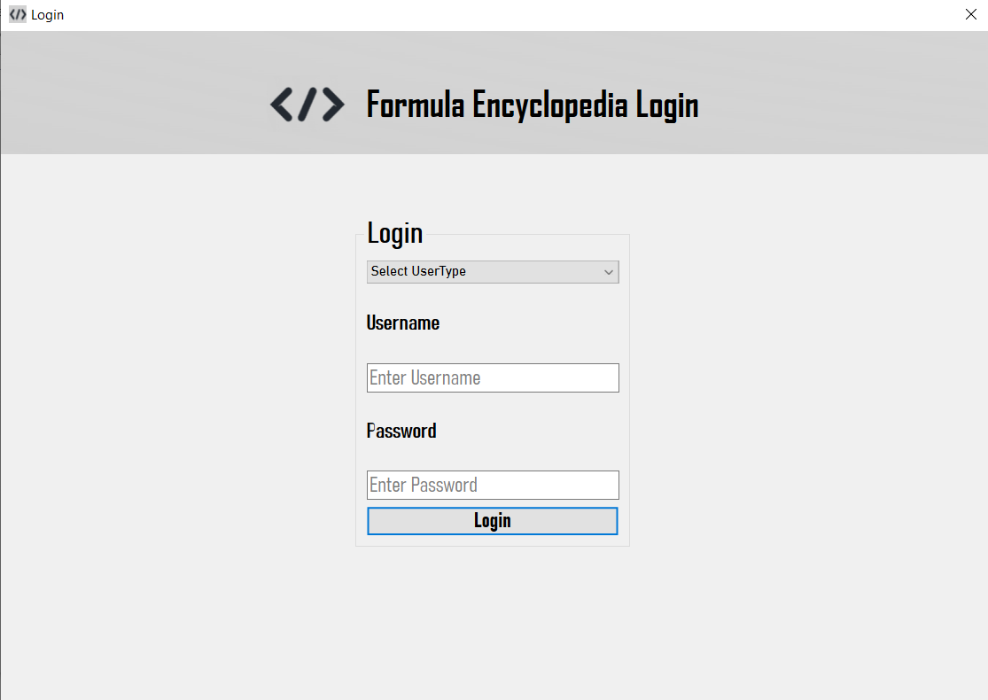
Login Page

Slide 10
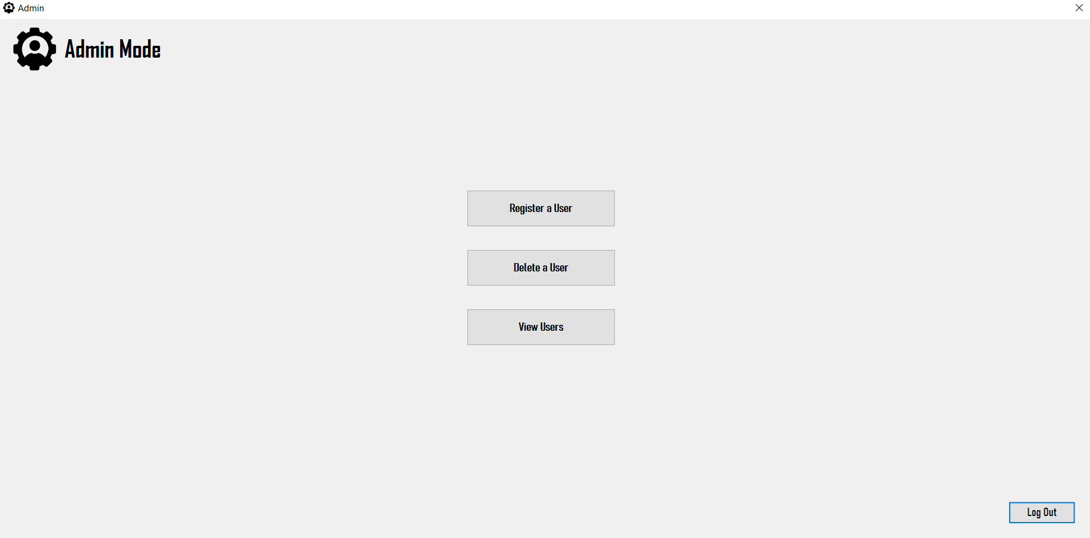
Mode1 : Admin Mode

Slide 11
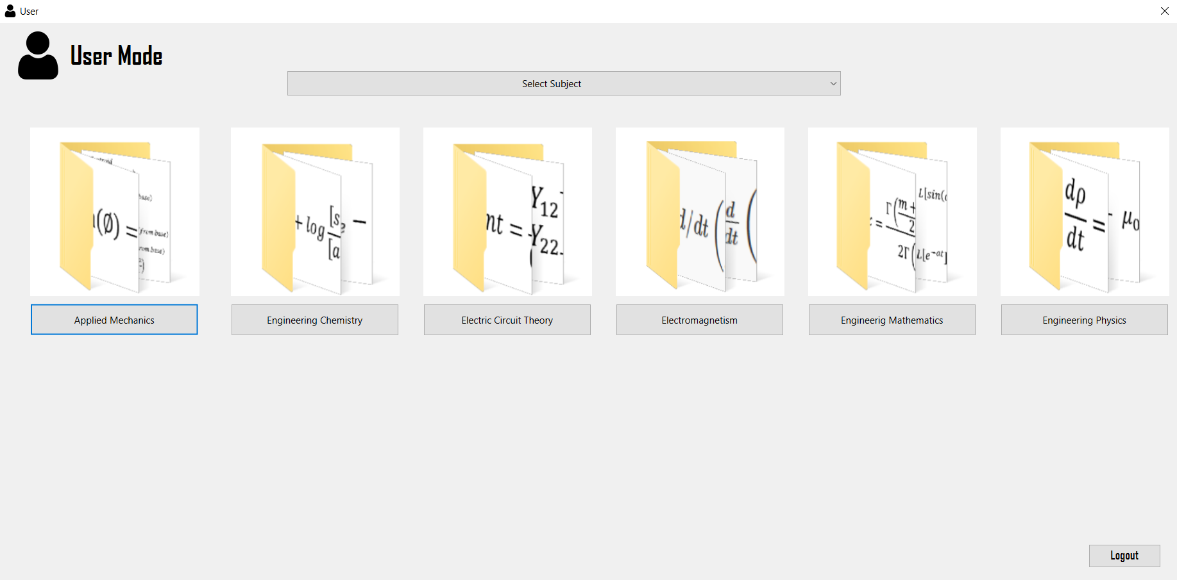
Mode 2: User Mode

Slide 12
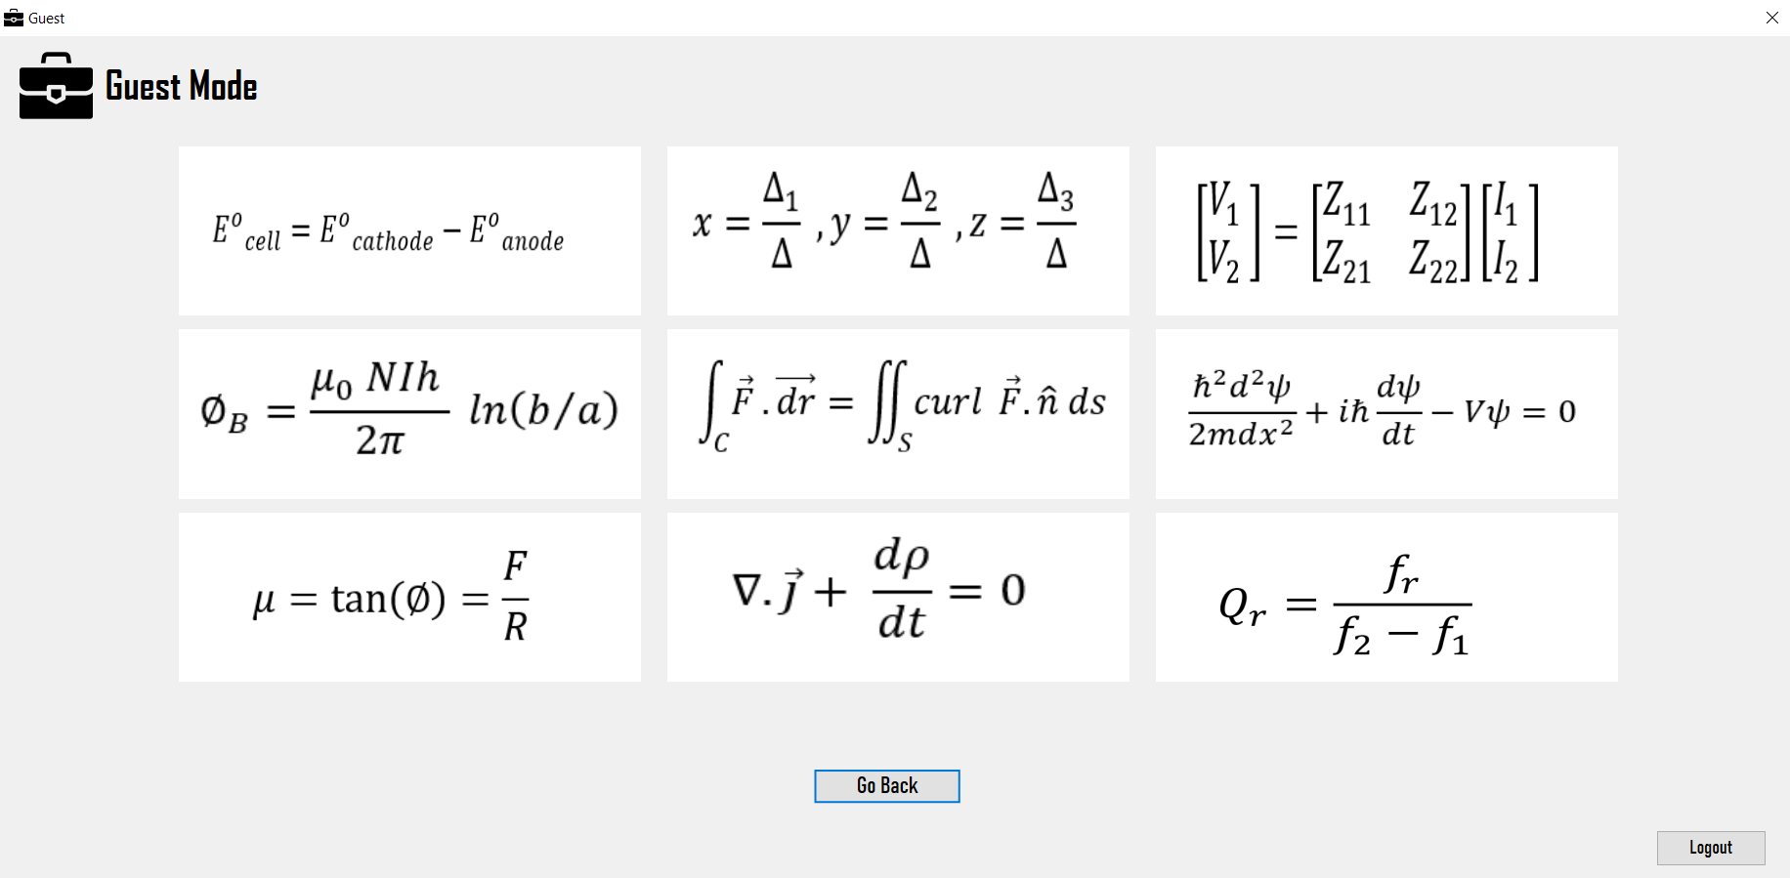
Mode 3 : Guest mode

Slide 13
THANK
YOU !!
Team
Atul Shreewastav
Bidhan Acharya
Nischal Paudel
Yugratna Humagain

